Slide 1


Introduction to Logistikbus
D
Master Slidedeck

Slide 2
Agenda :-
Introduction
Logistikbus Modules for Retailers
Other Interfaces Systems
Master and Confidential Data
Master Data Distribution
Logistik System Requirement [As Per Existing Application]
Glossary

Slide 3
Introduction :-
Logistikbus is a strategic supply chain management system provided by GSP that networks all the parts suppliers to ensure effective delivery processes.
Logistikbus represents a central warehouse management system for all dealerships in Europe.
Optimizing the core logistics processes for Daimler Detail Dealerships, Contracting Partners.
Objective :-
Logistikbus is to standardize the ordering and scheduling processes for Daimler retail dealerships and contracting parties.
Logistikbus has complemented several DMS (Dealer Management System) systems
Logistikbus module can provide order processing transparency at all sales levels.

Slide 4
Logistikbus Modules for Retailers :-
4 Different Modules of this logistikbus system
Logistikbus Database
Logistikbus Modules for Retailers
RIMS (Retailer Inventory Management System)
SCOT (Supply Chain Order Tracing)
SICOS (Stock Information and Controlling System)
StarOrder (Ordering system for immediate demands)
RIMS module can be use by Retailers for stock ordering and the Logistikbus database provides the data for calculating and scheduling, RIMS creates a calculated order proposal for stock reload
SCOT module is used by the ordering customer to view the parts that have not yet been delivered and discover at which stage in the logistics chain they are being processed.
SICOS you can obtain stock information about all your retailers
StarOrder module, VOR orders are placed directly to the supplying ELC or to investigate the status of your own orders online in the ELC’s system

Slide 5
Other Interfaces Systems :-
Logistikbus has interfaces to company suppliers and other dealerships
User Interfaces
SCART
STOX
DIMS/RIMS
SCOT
SICOS
StarOrder
StarOrder +
CORS
LBPS
The Logistikbus database has a connection to the RIMS server where all calculations are conducted
DB
External systems storage in the database.
Daimler retail dealerships’ dealer management systems (DMS):
Autoline 8.3
Cogestib
DAS Navision
Davis
Kobra
SPICS
V1 (order processing in the GLC, e.g for Unimog)
EvoBus

Slide 6
Master and Confidential Data :-
Data sources
Global parts master information
(Entire Supply Chain)
National parts master information
(All country-specific)
Local parts master information
(Not global and the national parts master)
PRIMUS parts master (The GLC’s central parts master)
SPICS (Spare Parts Inventory Control System)
e.g. denominations, recommended retail price (RRP) other specifications
e.g. current stock location and local retail price (RP)
e.g. part alternatives, marketing codes

Slide 7
Master Data Distribution :-
Various parts master information is collected in the database which based on :-
Various checking criteria
Various sources
All application areas

Slide 8
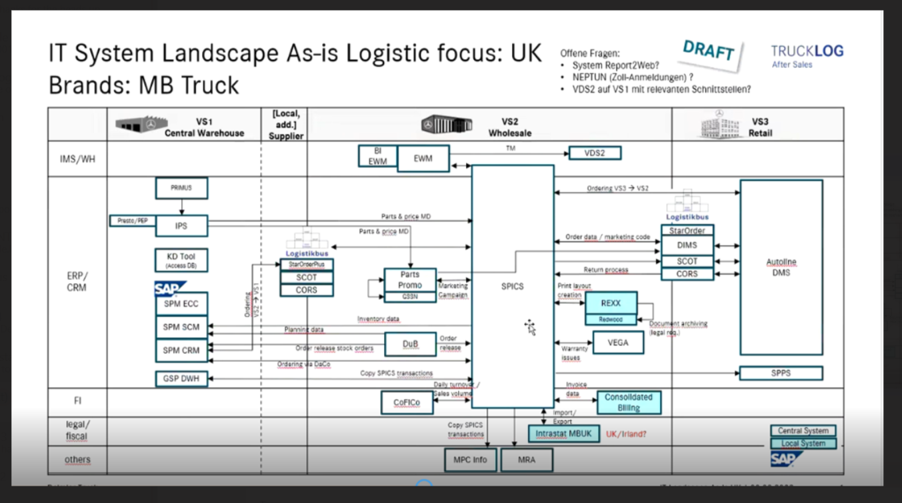
System Landscape:-
Various parts master information is collected in the database which based on :-
Various checking criteria
Various sources
All application areas

Slide 9
Logistik System Requirement [As Per Current Application]
Hardware
Web Browser
PC with at least 1 GHz
Minimum : 256 MB , recommended 512 MB working memory
Internet connection is required
400 MB free diskspace
Microsoft Internet Explorer 6.X or newer
Network Infrastructure
Local host files or a local DNS-Server is required for name decoding
Port 80 and 443 has to be opened by your provider
Software
Operating System:
Windows 98 or higher
Windows NT 4.0 or
Windows 2000 or
Windows XP recommended
Adobe Acrobat Reader 7.0 recommended
Monitor Infrastructure
17” Cathode monitor or 15” TFT required
Screen resolution at least 1024 x 768, recommended 1280 x 1024
Important
Microsoft Internet Explorer 6.x or higher with Virtual Java-Machine installed (is a part of Internet Explorer) or Java Plug-in 1.5.x by SUN
The Reaction time will be shortened when the Workstation is equipped better.

Slide 10
What is RIMS and How it Works
RIMS is an essential element of Logistikbus, it calculates order proposals for stock replenishment that are then processed in Logistikbus.
Logistikbus is the first system to introduce a new message concept to parts inventory management. In critical stock situations RIMS displays messages about these critical parts, you can then process the parts directly in Logistikbus.
To start RIMS, select RIMS from the left-hand hand menu bar from the Logistikbus application.
RIMS
Parts Master
Demands and Forecasts
Orders
Stock Depth
Messages
Order Overview
Order Editing g
Additional Order

Slide 11
System Settings in RIMS
RIMS requires various company-specific settings.
System Settings RIMS
Dealer Data
Dealer Master Data
Dealer Parameter
Supplier Parameter
External Supplier
The company data is initially created centrally
Insert your company’s contact data.
your account numbers for all the different brands you currently hold
In the System Control application from tab 9 is Company Suppliers
These parameters are processed centrally.
This is where all external suppliers of a selected company are listed. DaimlerChrysler establishments and contracting partners can maintain these parameters themselves and create new suppliers.

Slide 12
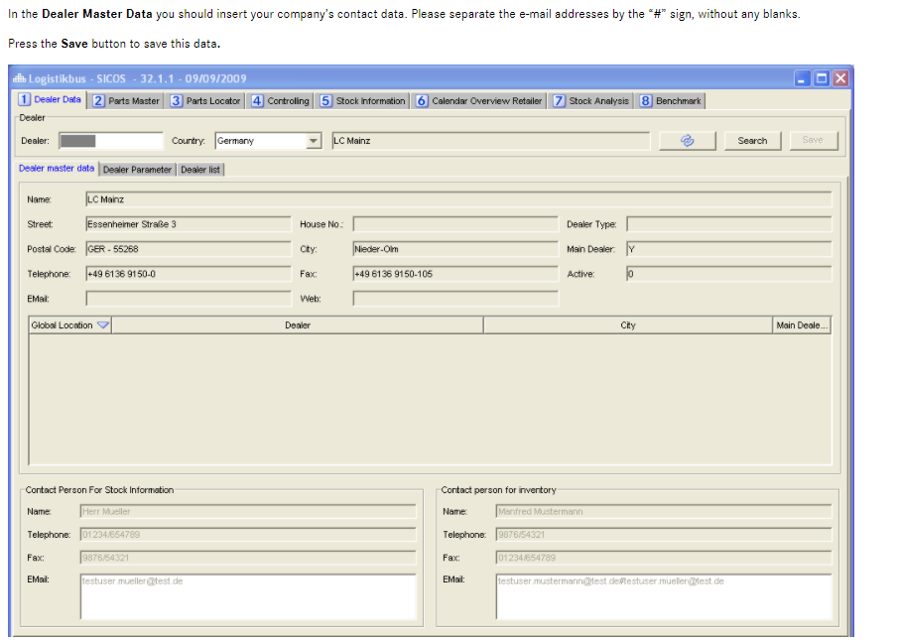
System Settings in RIMS

Slide 13
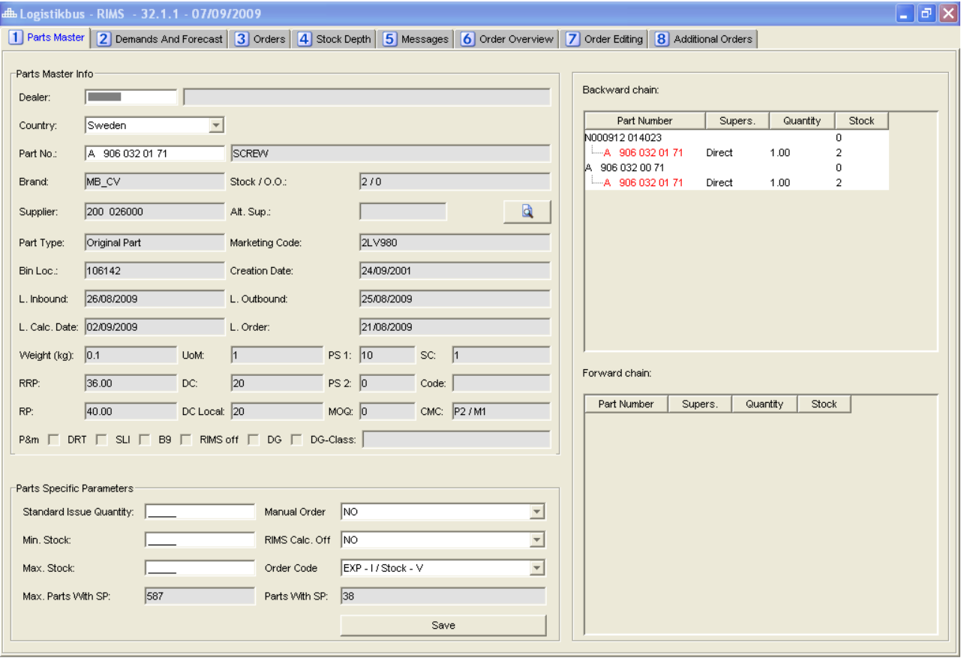
Parts Master Data in RIMS
To view parts master data and set parameters, select RIMS from the menu bar. Then select the Parts Master (tab 1) screen. In the Location field enter your company number (GSSN number). In the Country field select the country in which your company is located. This country setting is saved and entered each time RIMS is called up again. In the Part Number field please enter the required part number then press enter.

Slide 14
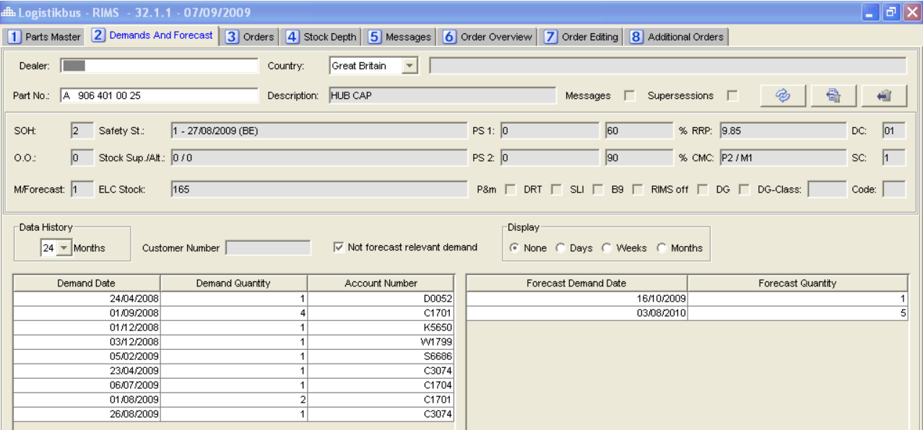
Demand and Forecast in RIMS
When switching to tab 2 Demands and Forecasts screen, the part information is relayed to the scheduling header and all demand for the previous 12 months and the forecast for the next 12 months are automatically displayed.
Using the Display filtering criterion, you can display detailed demand and forecasts. In the list you can switch between every day, weekly or monthly display. You will then see all demand and forecasts for the period. Periods or demand are represented by 0.0.

Slide 15
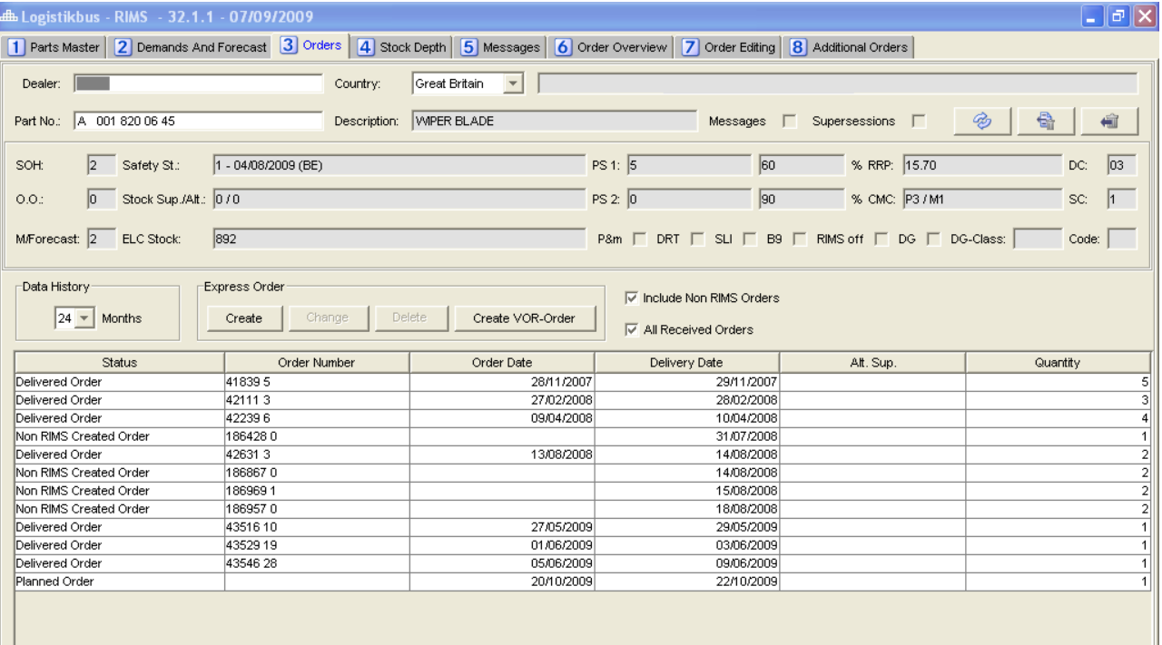
Orders in RIMS
Orders screen you will now see the open orders and the planned availability date. To gain more information on the backordered part “double click” in the O.O field on the screen header and SCOT will automatically be opened. Based on the order number input, you can track the order in the SCOT application and determine at what stage of processing the order has reached with the supplier.

Slide 16
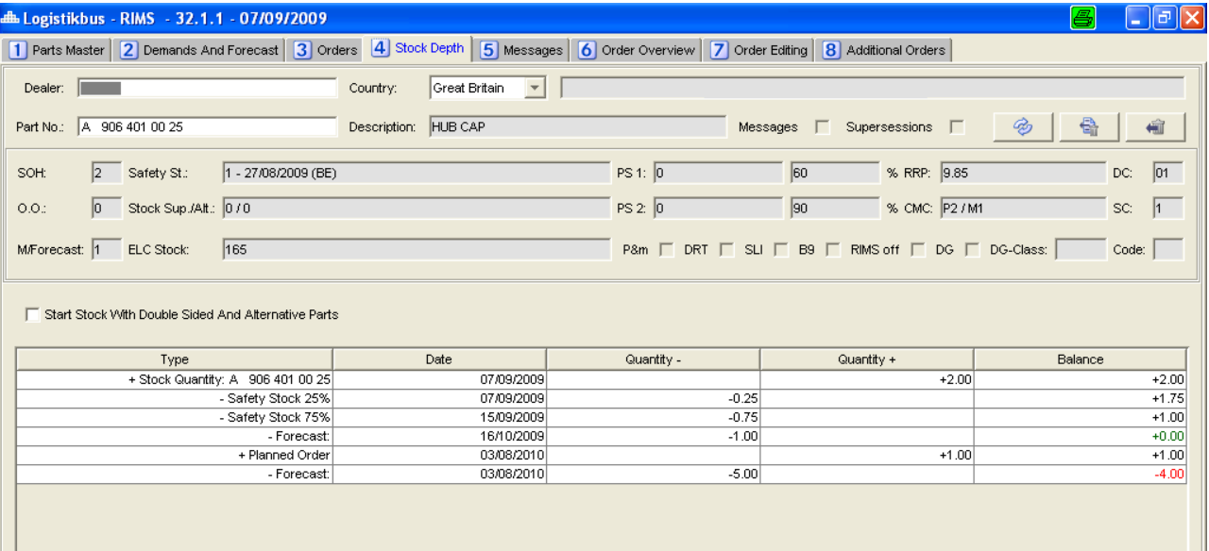
Stock Depth in RIMS
In tab 4 Stock Depth screen you will see the current stock on hand and future forecast movement of a particular part item. If a forecast produces a negative stock the calculated stock will be displayed in red.

Slide 17
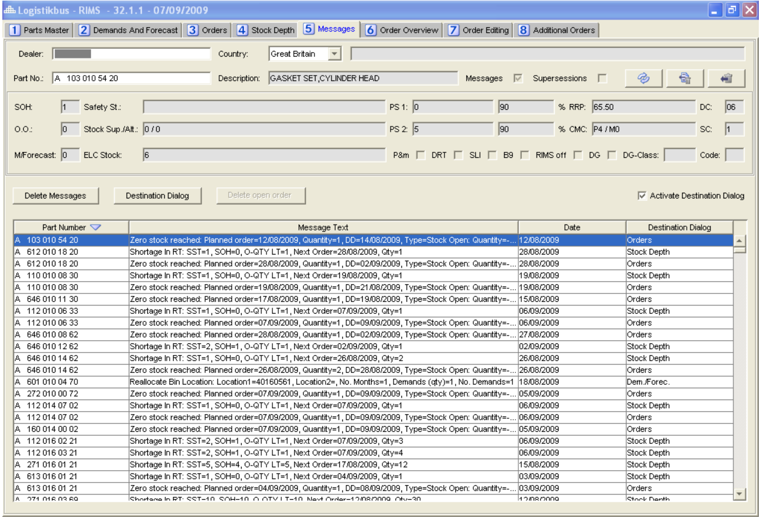
Messages in RIMS
Logistikbus implements a new message concept. It allows critical situations with regard to particular parts to be recognized at an early stage. These messages are displayed in RIMS in tab 5 Messages screen.

Slide 18
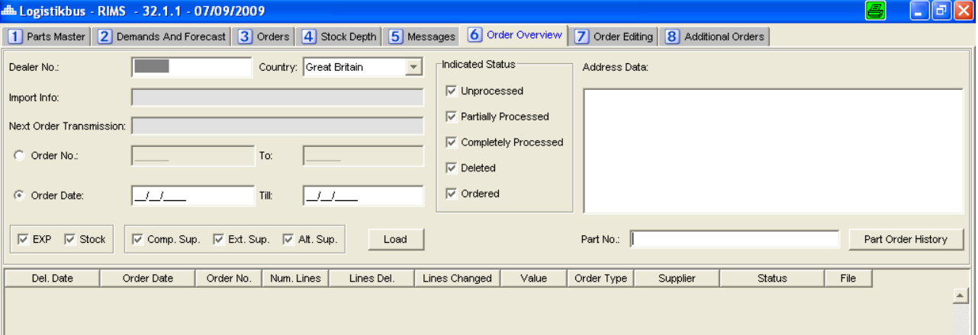
Order OverView in RIMS
All orders for a selected company are displayed in tab 6 Order Overview screen. You can then select the following various options in the screen header.
The system defaults to showing just todays date so if you only enter the company number and the country code, today's order proposal will be displayed.
Order Number [from - to] | You can limit the search according to order number.
Order Date [from - to] | You can limit the search according to order date.
Indicated Status | You can tick to show the orders displayed by status.
EXP or Stock | Select whether just express or just stock replenishment or both types of order should be displayed.

Slide 19
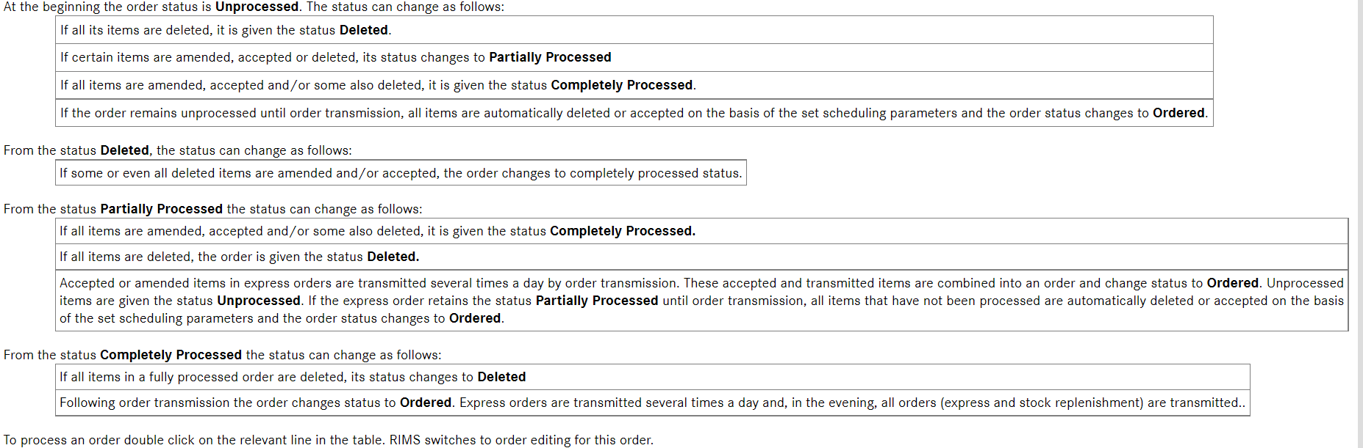
Order OverView in RIMS

Slide 20
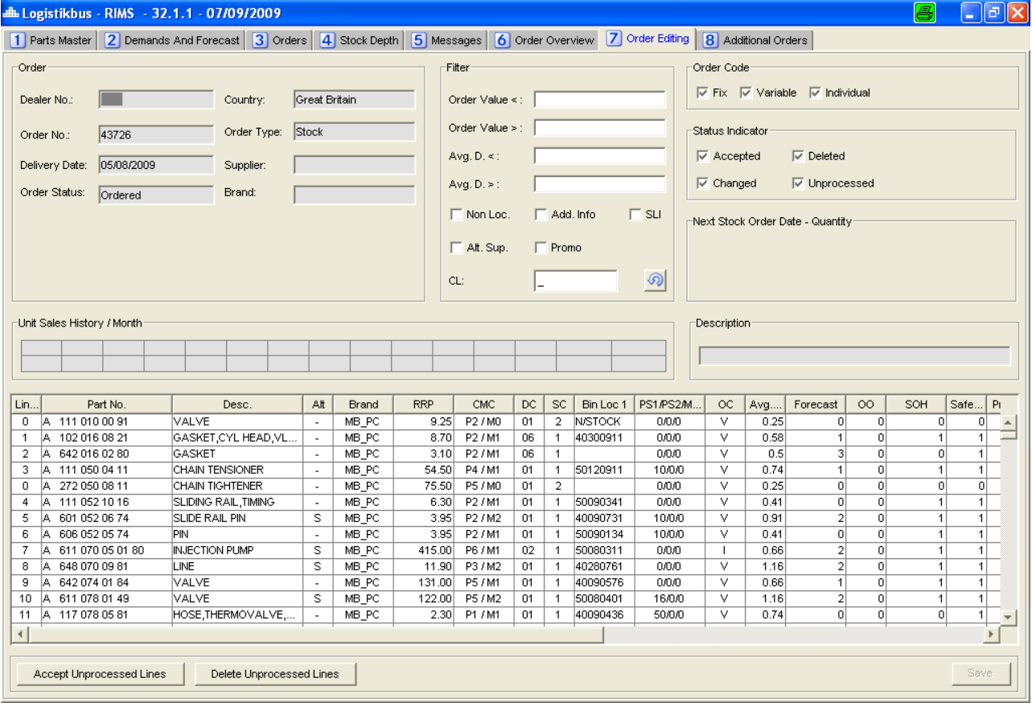
Order Editing in RIMS
In the upper half of tab 7 Order Editing, you will find order information. You can identify the order type, the order status, the supplier and the delivery date. In the Unit Sales History / Month field the monthly demand for the previous 12 months, the actual month, the total demand and the resultant average demand per month are displayed.

Slide 21
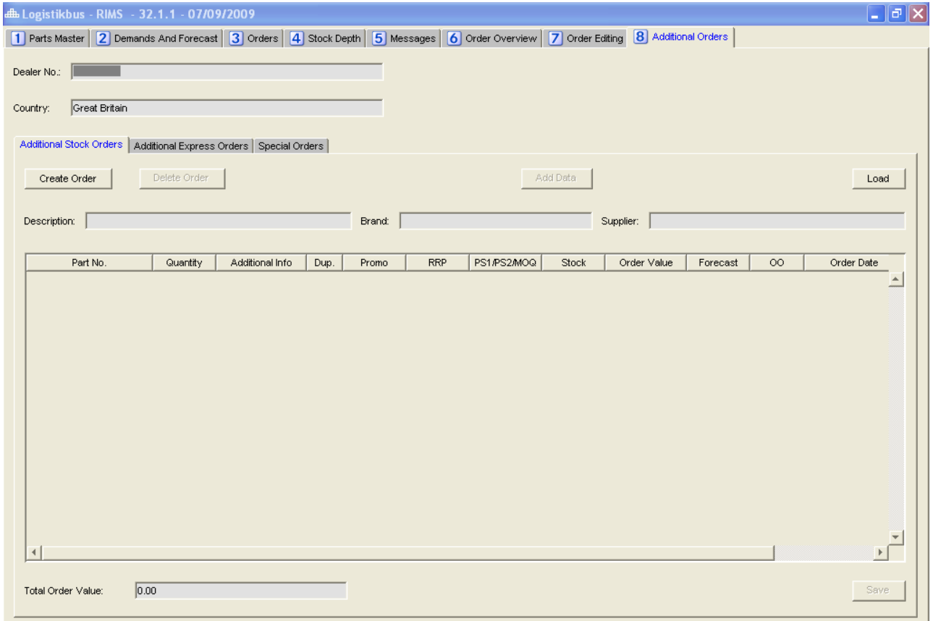
Additional Order in RIMS
In tab 8 Additional Orders screen you can enter manual orders, orders in addition to the automatically scheduled orders.
In the case of additional orders, a differentiation is made between special orders and additional orders. Additional orders can only be created in the form of stock replenishment orders. Additional orders can be created as either stock replenishment or express orders. Special requirements have no effect on forecasts.

Slide 22
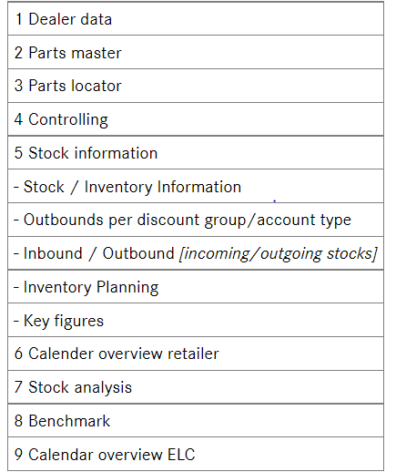
About SICOS
SICOS (Stock Information and Controlling System) is a further logistikbus module. You will find your dealer master data in SICOS. Using SICOS you can call up stock information from other DaimlerChrysler establishments and contracting partners. To do this SICOS provides daily updated stock information.
SICOS supports you in your stock management with the facility of calling up a variety of stock data. In SICOS key figures and filtered data for range of stock is clearly displayed and can be imported into MS Excel if required. The data in the controlling and stock information screens is updated on a weekly basis (Sunday).
To start SICOS select SICOS from the menu .You will now see a screen showing you the following tabs:

Slide 23
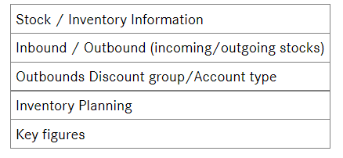
SICOS: Extraction of Data
For simple extraction of data in SICOS you can create favorite companies as company lists. In this way you can, carry out a quick stock check within your region. To create company lists, go to the Stock Information screen. There click the radio button next to the Dealer List field, then the button to the right of the dealer list field.
In SICOS you can search the daily updated parts stock of other DaimlerChrysler establishments and contracting partners for all company sectors. This is helpful in the event of urgent requirement or residue. To extract this stock information, select the Parts Locator screen.
In SICOS you have the facility to quickly extract and analyses your controlling data. You can call up this data for several companies using the company lists or a selected individual company. The data for controlling is added together on a weekly basis. In SICOS you can always extract the latest most up to date average and the monthly / yearly figures. Controlling data is subdivided into 5 areas:

Slide 24
LBPS And STOX
For simple extraction of data in SICOS we have one module which is Logistikbus Parameter Supplier.
Using this module stock analysis can be performed in SICOS.
Stock analysis can be performed on different parameter .
STOX is an module which is used by dealers to announce inventory parts present with them.
Dealer Parameter
Dealer Data
External
Supplier
Supplier Parameter

Slide 25
Glossary :-
RIMS/DIMS | Retailer/Dealer Inventory Management System, the scheduling module in Logistikbus
DMS | Dealer Management System, the dealers’ own system for EDP-technical development of service processes. The most common DMS having interfaces to RIMS/DIMS are Autoline and Davis, there are however several others.
GLC | Global Logistics Centre. This refers to the central warehouse in Germersheim
GSP | Global Service & Parts combines the worldwide activities of the Daimler after-sales business; the technical, logistical and marketing sectors are the main activities within GSP
ELC | European Logistics Centres ensure operational part logistics for Mercedes-Benz, Maybach, smart and for Chrysler/Jeep dealers
MPC | Market Performance Centre
Retail | Dealerships’ sales level in the supply chain
ROP | Replenishment Order Proposal
SCOT | Supply Chain Order Tracing, the module in Logistikbus for recognizing the status of orders
SICOS | Stock Information and Controlling System. The controlling module in Logistikbus
SPICS | Spare Parts Inventory Control System, an IT stock controlling system used at the ELCs
StarOrder | Immediate requirement order module in Logistikbus
Wholesale | ELCs’ sales level in the supply chain

Slide 26


THANK YOU

